Slide 1


Slide 2

Data Science is all about experimentation
•
Three stages for each experiment:
Thinking
Coding
Execution
More experiments = higher chance of
success
•

Slide 3

Poor man's solution
•
Code project in a (long) single ﬁle
Problem: Not maintainable
No clear boundaries among tasks
Leads to unwanted interactions We need reproducible and
maintainable projects
•
•

Slide 4

Why bother about maintainability?
Without a lot of structure, we forget what we’ve done in the past, we can’t read each others’ work, and we can’t test whether what we’ve done is correct.¹
— Patrick Ball
Image: https://unsplash.com/photos/r6mBXuHnxBk
¹ https://hrdag.org/2016/06/14/the-task-is-a-quantum-of-workflow/

Slide 5
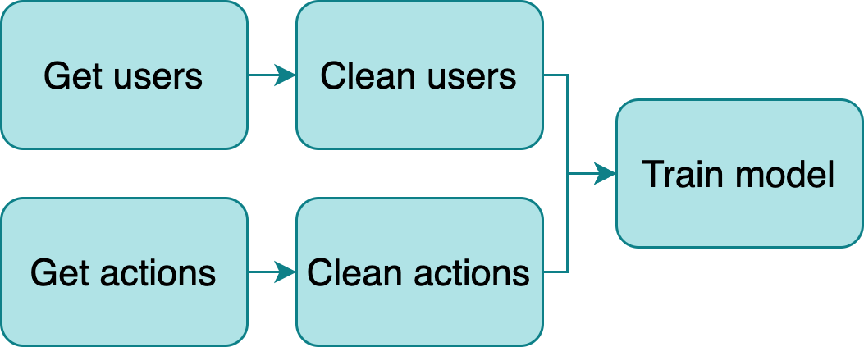
Build a data pipeline
•
Break down logic in small tasks
Outputs become inputs of downstream
tasks
New challenge: Manage structure
Multiple ﬁles
Route outputs
Orchestrate execution
•
•

Slide 6

Current approach: Workﬂow managers
•
Frameworks to develop pipelines (Make, Airﬂow, Luigi, etc)
Problems:
Learn a new tool
Write pipeline code
Adds unnecessary complexity
•
Image: https://unsplash.com/photos/l090uFWoPaI

Slide 7
Ploomber
Adheres to a convention over conﬁguration philosophy, to allows us to write pipelines with a focus on usability.
Three conventions:
Each task is a script
Scripts declare dependencies via an upstream variable
And outputs via a product variable

Slide 8
Main features
•
Python, R and SQL⁴ supported⁵
Parametrized pipelines with auto-generated CLI Testing (i.e., run data tests upon task execution) Debugger integration (pdb and ipdb)
•
•
•
Any database with a DBAPI 2.0 client or compatible with SQLAlchemy is supported
Languages that have Jupyter kernels are supported with a few limita9ons

Slide 9

Integration with Jupyter
•
Scripts open as notebooks³
(Temporary) cell injection
Ensures no hidden state by running
ploomber build
•
•
³ Thanks to jupytext! https://github.com/mwouts/jupytext

Slide 10
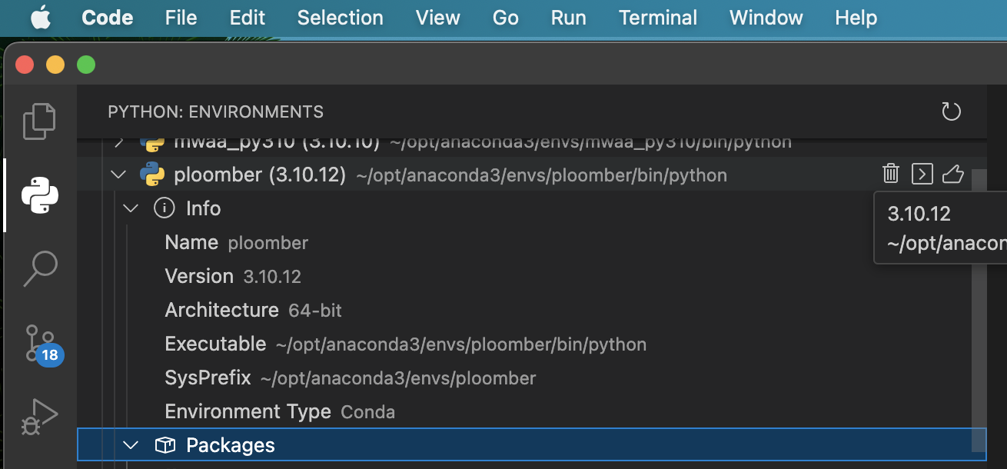
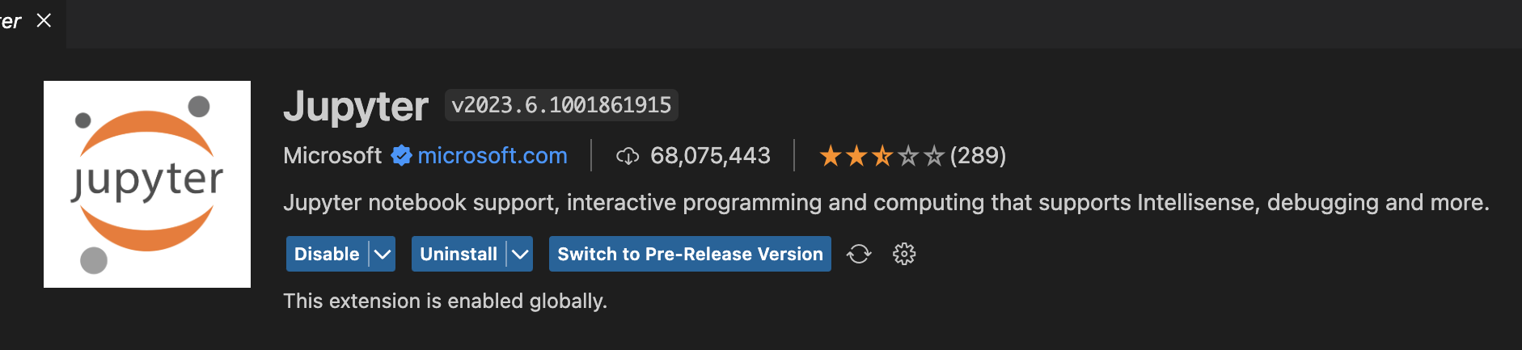
Setup Env: Install Ploomber and enable Running R notebooks in VsCode
Create a python 3.10 environment
> pip3 install ploomber
Install the Jupyter extension in VsCode
R Run: >install.packages("IRkernel")
R Run: >IRkernel::installspec()
Create a new file with .ipynb file extension and open it
Select the R kernel to use.
Run r youR Code in it.

Slide 11
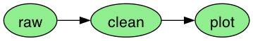
R workﬂow Example1
1. Input
3. Result
raw.R
clean.R
plot.Rmd
output/
raw.csv
raw.ipynb
clean.csv
clean.ipynb
plot.ipynb
2. Execute
ploomber build --entry-point .

Slide 12
R example 1: “pipeline.yaml”
tasks: # list of tasks
# use plain R scripts
- source: raw.R # write iris data to CSV
product:
# this is the executed version of your script
# you can review tables and charts here
nb: output/raw.ipynb # output notebook can also be html
data: output/raw.csv
- source: clean.R # clean iris data
product:
nb: output/clean.ipynb # output notebook can also be html
data: output/clean.csv # cleaned data
# R markdown files also supported
- source: plot.Rmd # plot iris data
product:
nb: output/plot.ipynb
# Quarto does not work yet :(
# - source: plot2.Qmd
# product:
# nb: output/quarto.ipynb

Slide 13
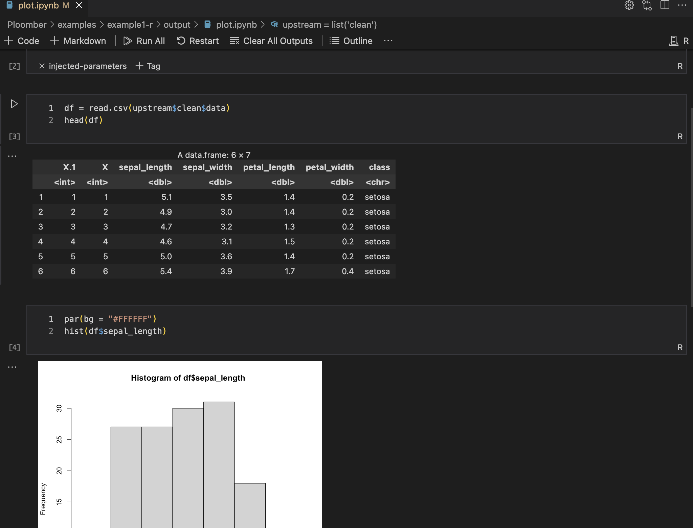
Tasks as notebooks
•
Tasks are converted to notebooks (.ipynb) before execution²
No need to write code to save tables or charts
Generate logs for each execution
•
•
² Thanks to papermill! h2ps://github.com/nteract/papermill

Slide 14
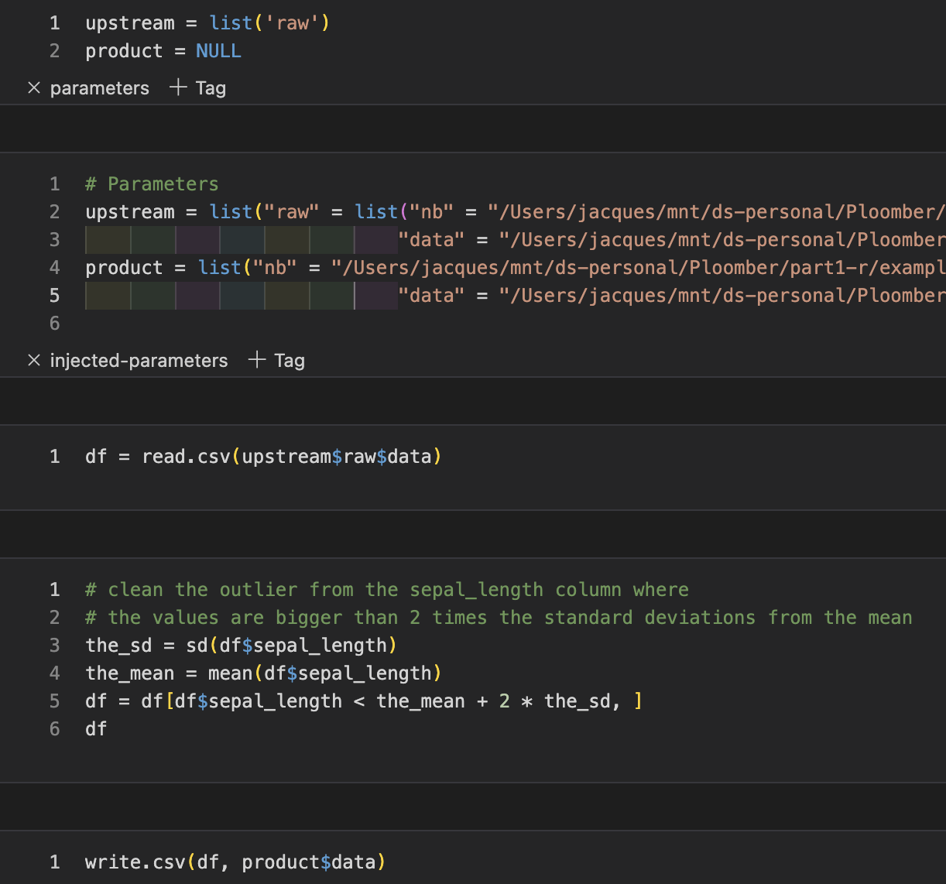
Tasks: R scripts/notebooks
clean.R
clean.ipynb
# + tags=["parameters"]
upstream = list('raw')
product = NULL
# -
df = read.csv(upstream$raw$data)
# clean the outliers from the sepal_length
# the values are bigger than 2 times the standard deviations from the mean
the_sd = sd(df$sepal_length)
the_mean = mean(df$sepal_length)
df = df[df$sepal_length < \
the_mean + 2 * the_sd, ]
df
write.csv(df, product$data)

Slide 15
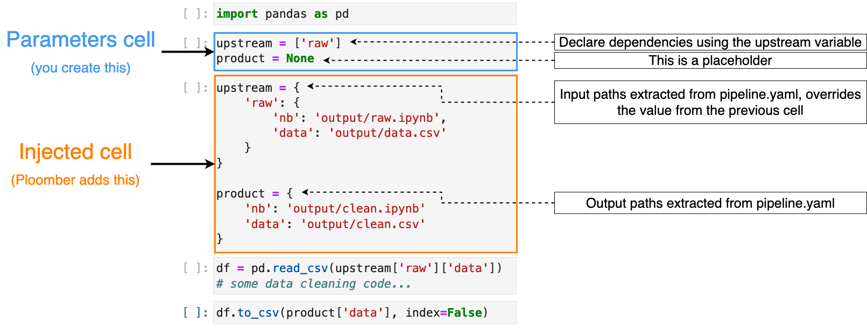
Cell injection concepts (Python)

Slide 16
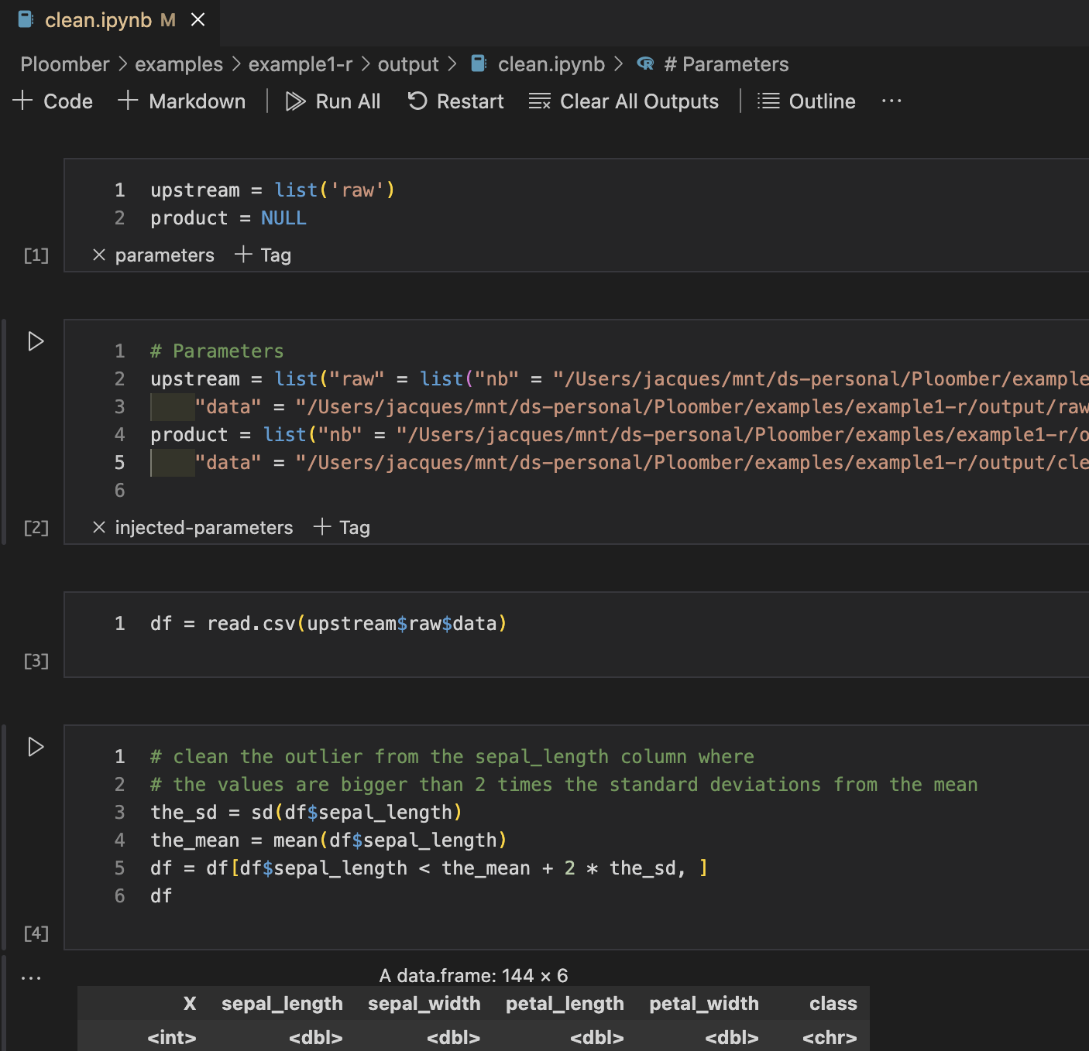
Cell injection: R notebook
See ‘parameters’ and ‘injected-parameters’ tags
Because the cleaning of the data are dependent on the raw data (upstream of ‘raw’ (raw.R) was requested, and upstream was replaced with the product output of raw.

Slide 17
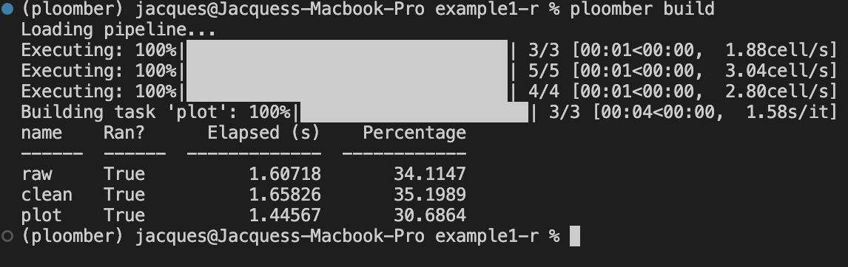
Build process
Extract upstream and product
Determine execution order using extracted upstream dependencies
Inject code. Replace the list of dependency names with a map of names to products
Execute the pipeline (skips up-to-date tasks)

Slide 18
Resources
Install: pip install ploomber
For updates/questons/feedback, follow me on LinkedLn:
https://docs.ploomber.io/en/latest/
https://docs.ploomber.io/en/latest/user-guide/r-support.html
Examples: github.com/ploomber/projects Website: ploomber.io
This presentation: blancas.io/talks/jupytercon-20.pdf
•
•
•
•

Slide 19
Thanks for watching!

